Slide 1
FACTORS CORRELATING
TO THE RISE OF
MASS SHOOTINGS IN AMERICA
Rashed Alkanawi, Leah Krause, Francis Rivera,
Vivian Sun, Michael H. Banning

Slide 2
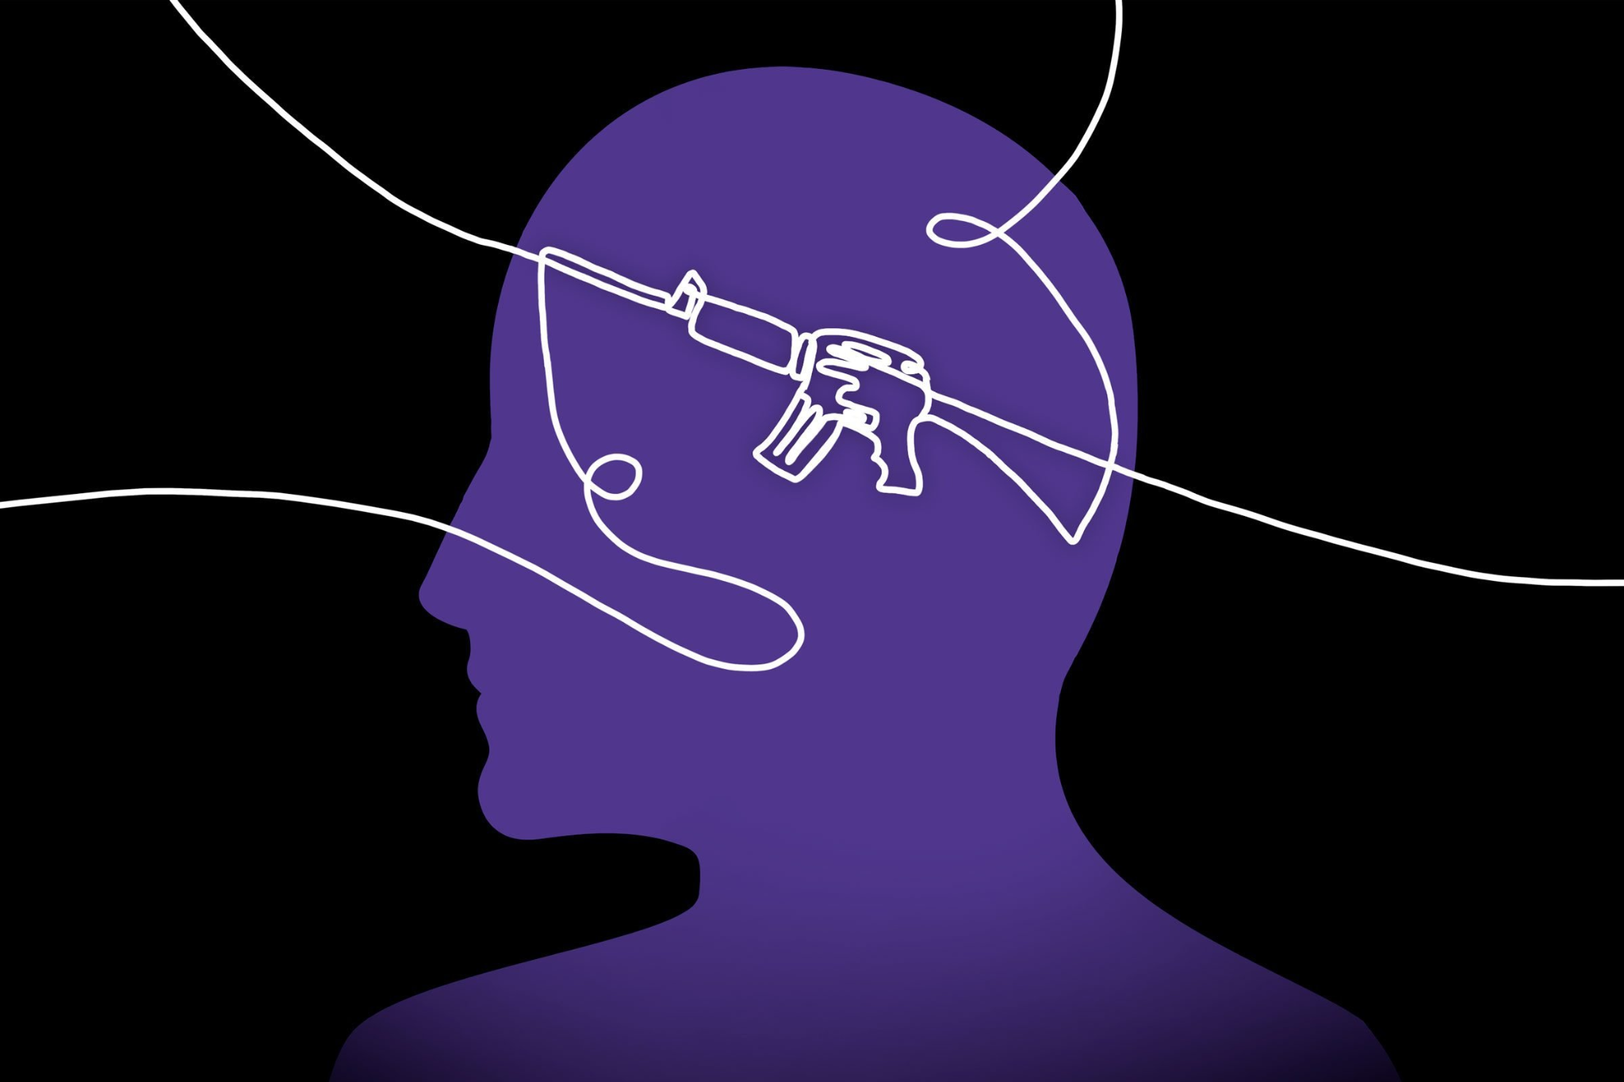
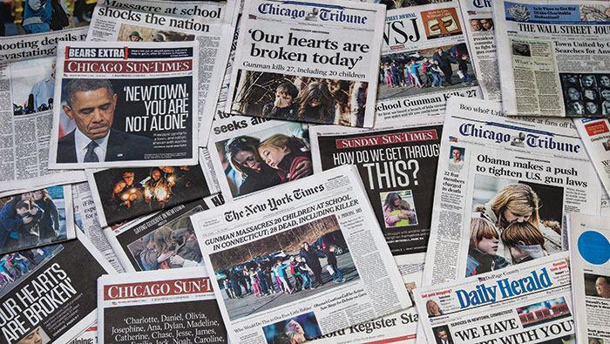


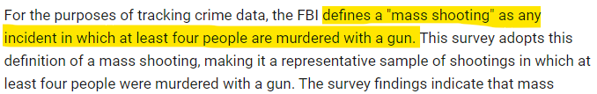
INTRODUCTION

Slide 3
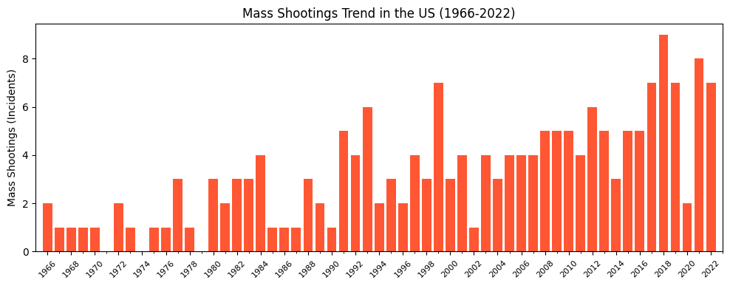
TREND OF INCIDENTS
Frequency
Rate of incidents are steadily increasing
2023
Current total: 4
Despite being only just over 3 months into 2023, there have been 4 mass shootings

Slide 4
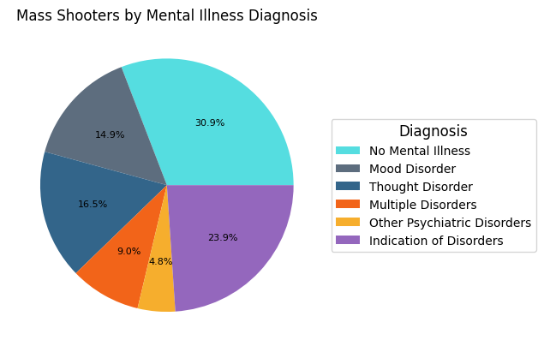
MENTAL STATE OF PERPETRATORS
Examples of Mood Disorders
Bipolar disorder
Depression
Examples of Thought Disorders:
Schizophrenia
Psychosis
Mania
Notes:
What was the mental state of perpetrators when they decided to carry out these acts?
Visual on mass shooter mental state broken down into different categories of disorders

Slide 5
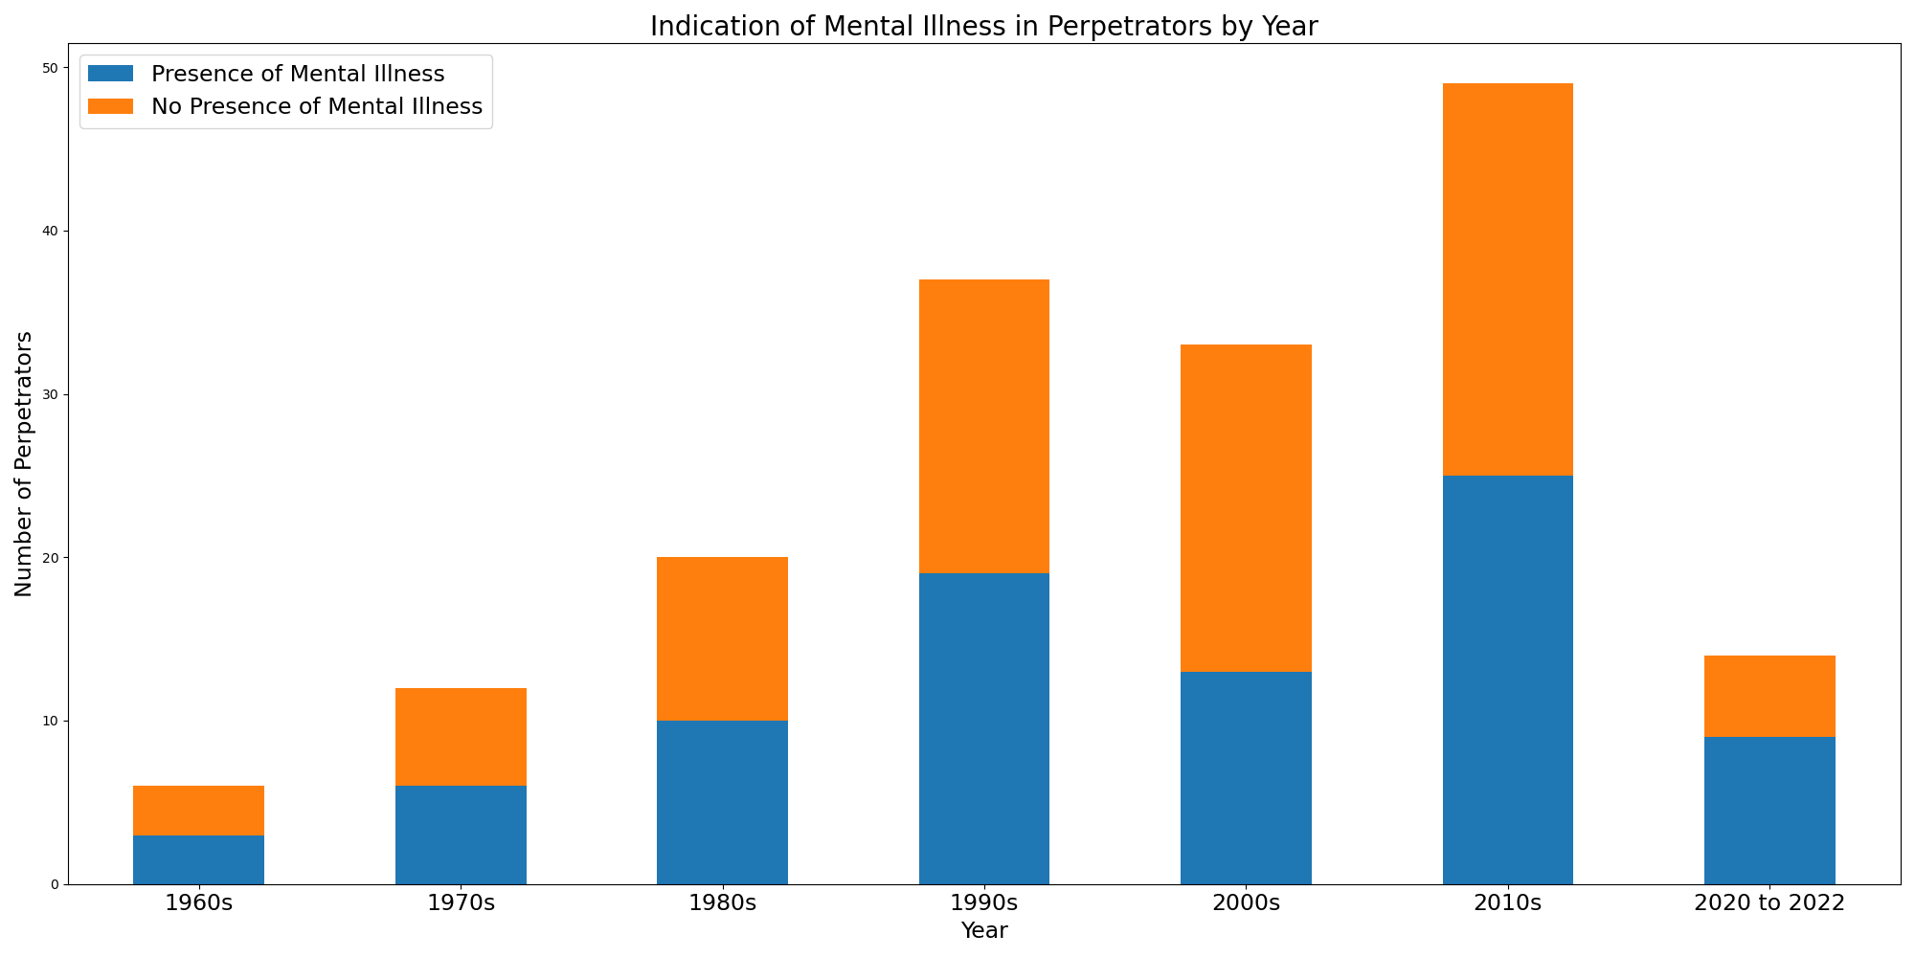
PRESENCE OF MENTAL ILLNESS IN PERPETRATORS
Notes:
Last several decades rate of mental illness presence appears to be even around 50/50
Last three years alone we are seeing a spike in mental illness presence
Mental illness may play a major factor in recent mass shootings

Slide 6
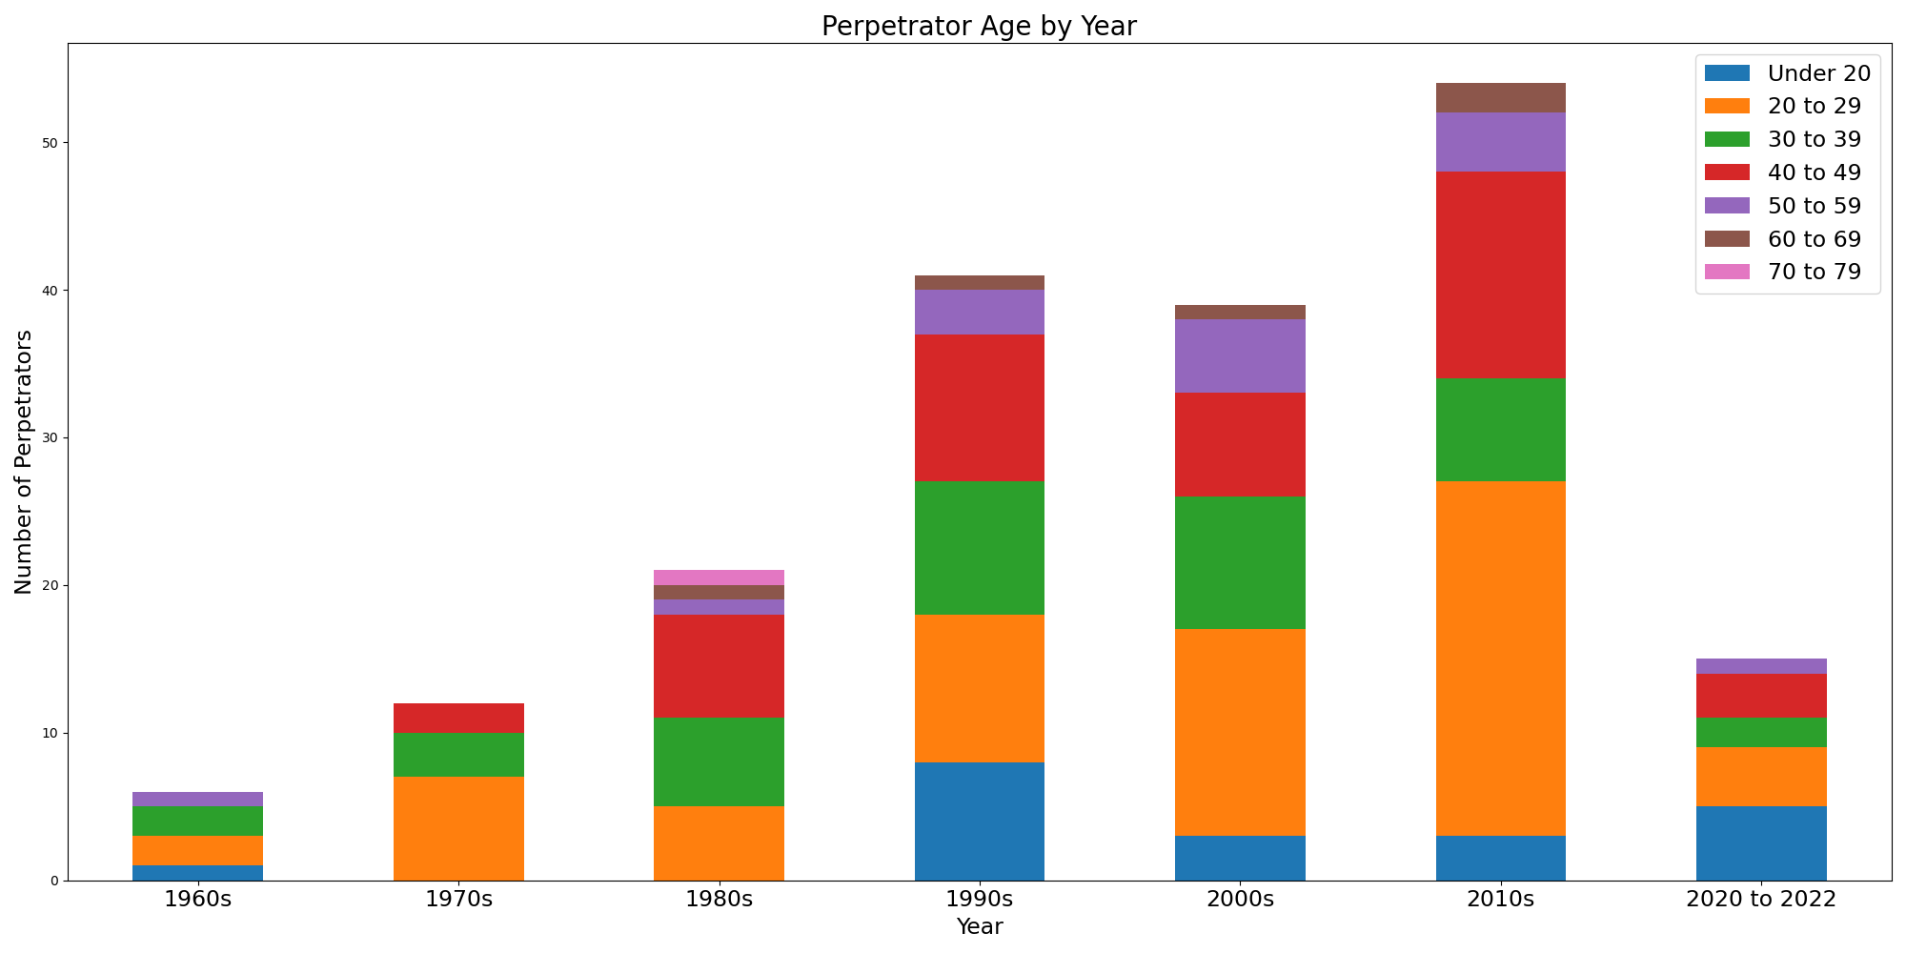
PERPETRATOR AGE BY DECADE
Perpetrators in their 20s - 35% of the data
Perpetrators in their 40s - 23% of the data
Rate of Perpetrators in Their 20s
1990s: 24%
2000s: 36%
2010s: 44%
Notes:
Narrowed down by decade, we can notice that the largest segment of perpetrators is those in their 20s, making up about 35% of our data. A close second is perpetrators in their 40s. Within the recent decades, we have seen a steady increase in the amount of perpetrators in their 20s, jumping from 24% to 44% from the 90s to the 2010s.

Slide 7
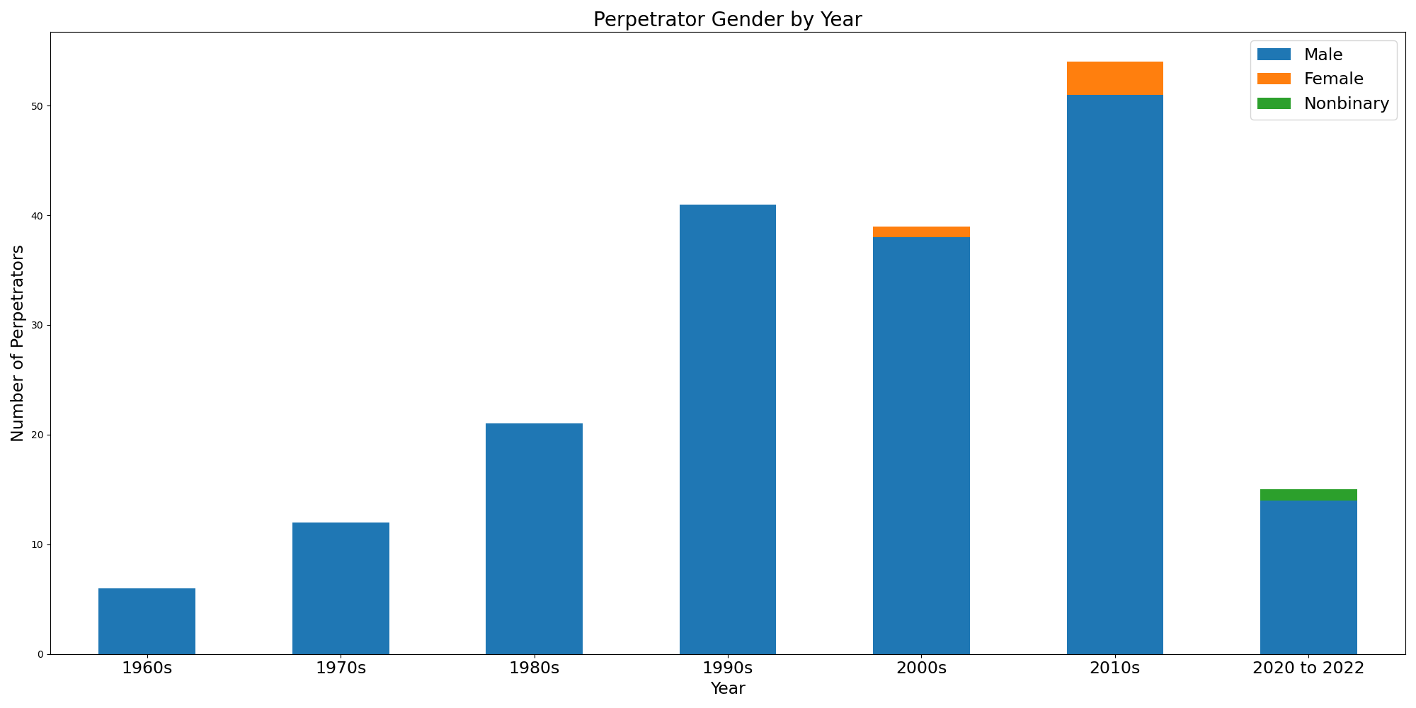
PERPETRATOR GENDER BY DECADE
97% of perpetrators are male
Notes:
Broken down by gender, we can see that 97% of perpetrators are male, with only a slight increase in female and nonbinary shooters within the last 20 years.

Slide 8
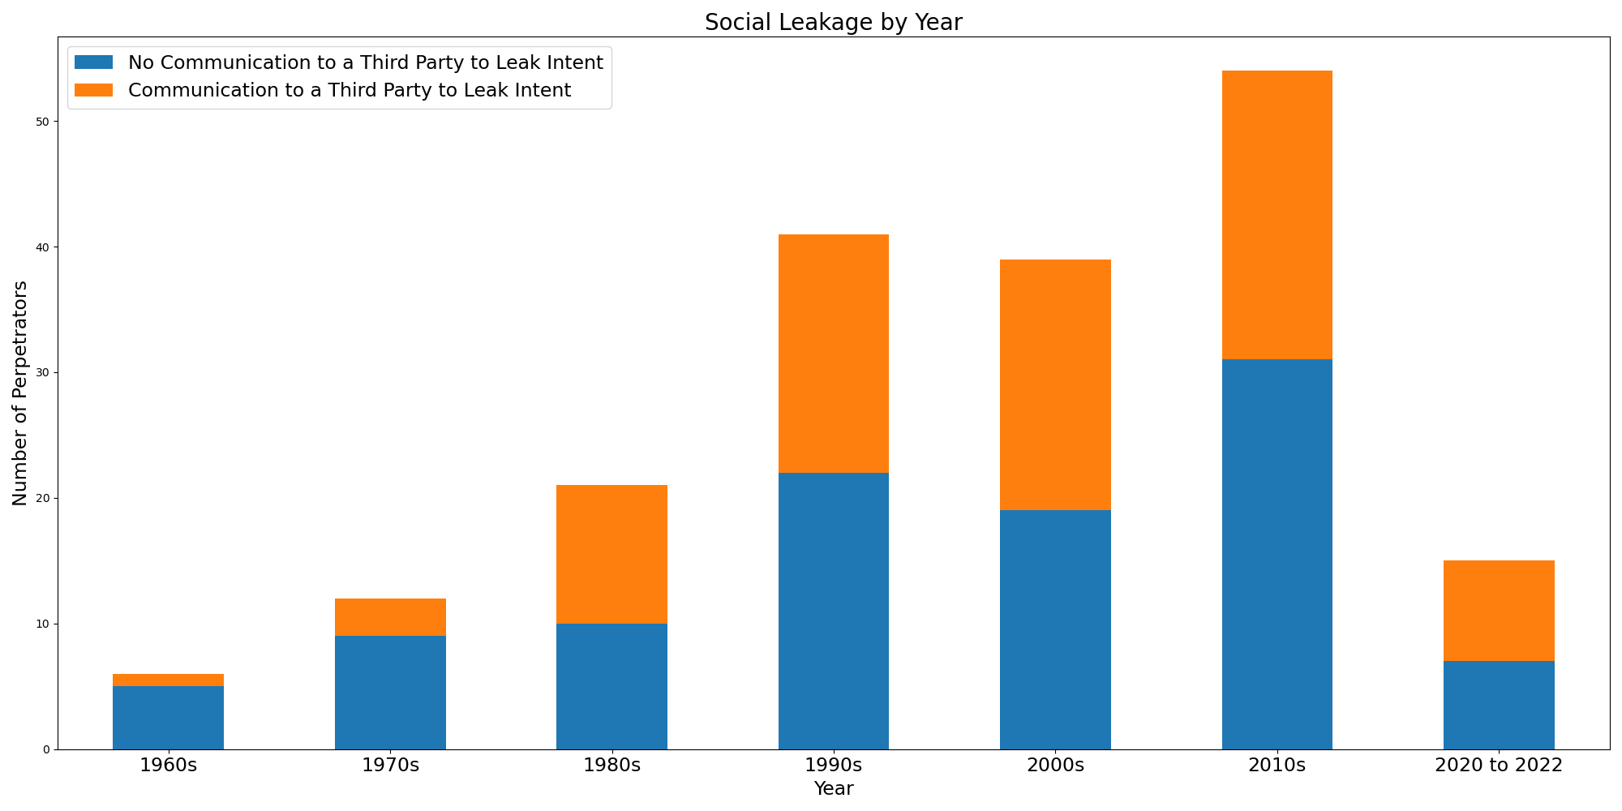
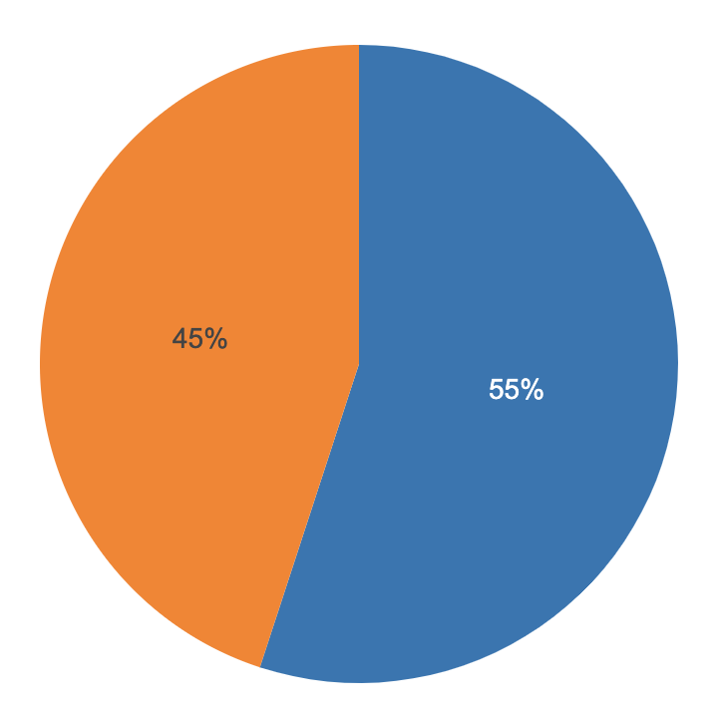
SOCIAL LEAKAGE BY DECADE
Overall, 55% of perpetrators did not communicate intent to a third party before
Notes:
On the next slide we can see a visual representation of intent communicated to a third party prior to the event. This is roughly split down the middle, with slightly more perpetrators not communicating intent beforehand. This metric remained stable as shootings increased with no trend either way.

Slide 9
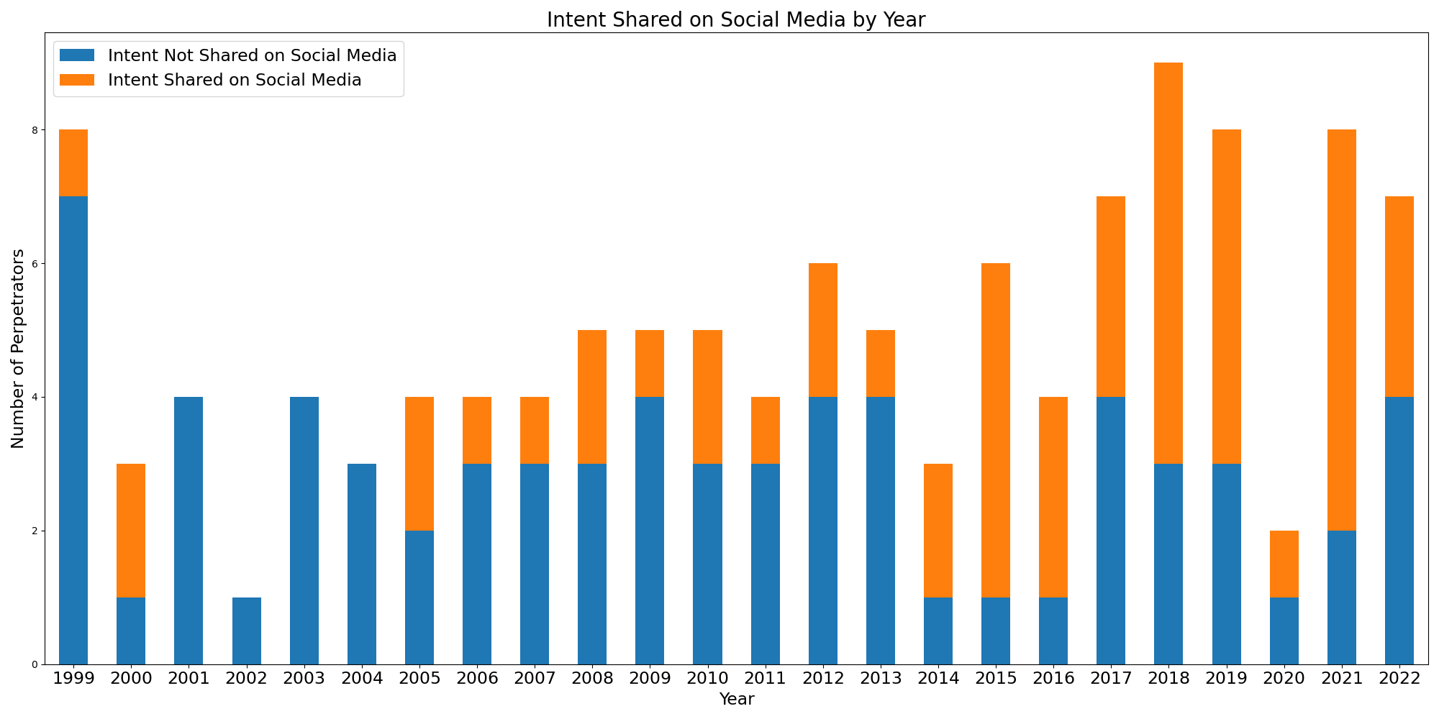
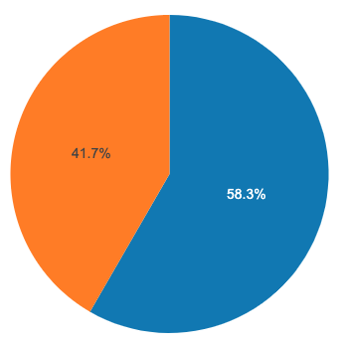
SOCIAL MEDIA USAGE BY YEAR
Notes:
Since 1999, sharing intent on social media has steadily increased over the years. While we cannot draw any conclusions on the upward trend of shootings over the past few years, it is interesting to note that we’re seeing more and more intent expressed on social media on blogs and in chat rooms, which starts a conversation about censorship and whether or not that’s necessary.

Slide 10
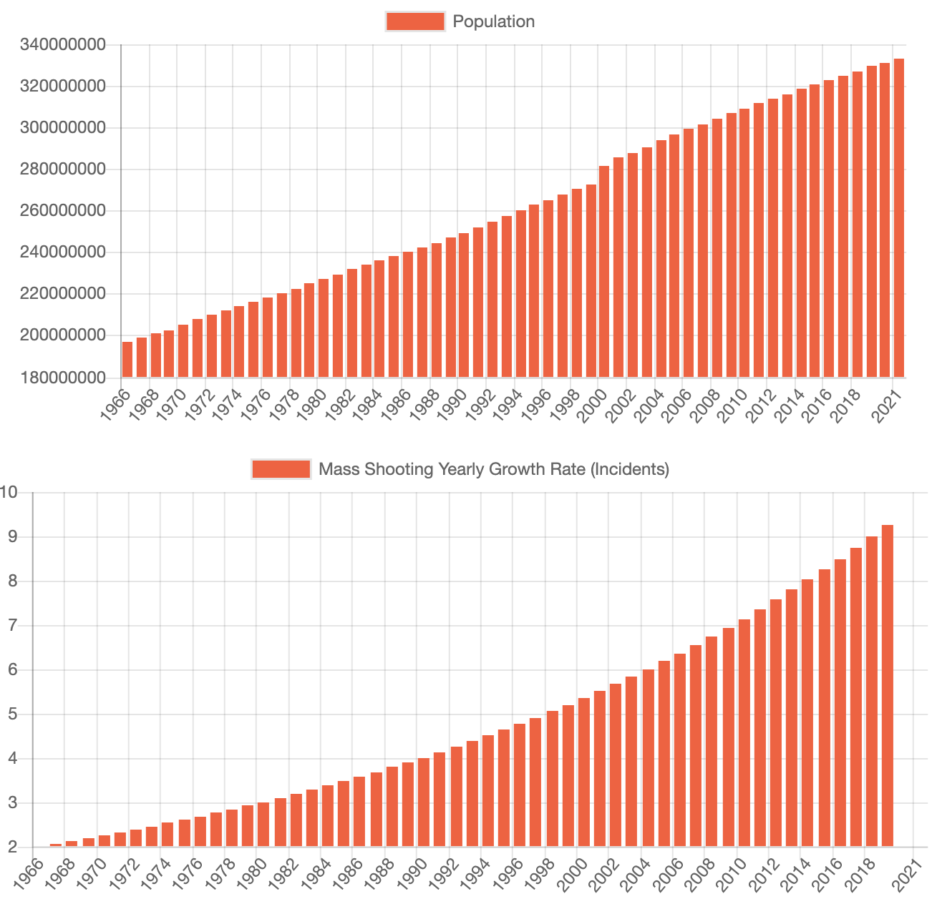

CHART.JS
https://www.chartjs.org/

Slide 11
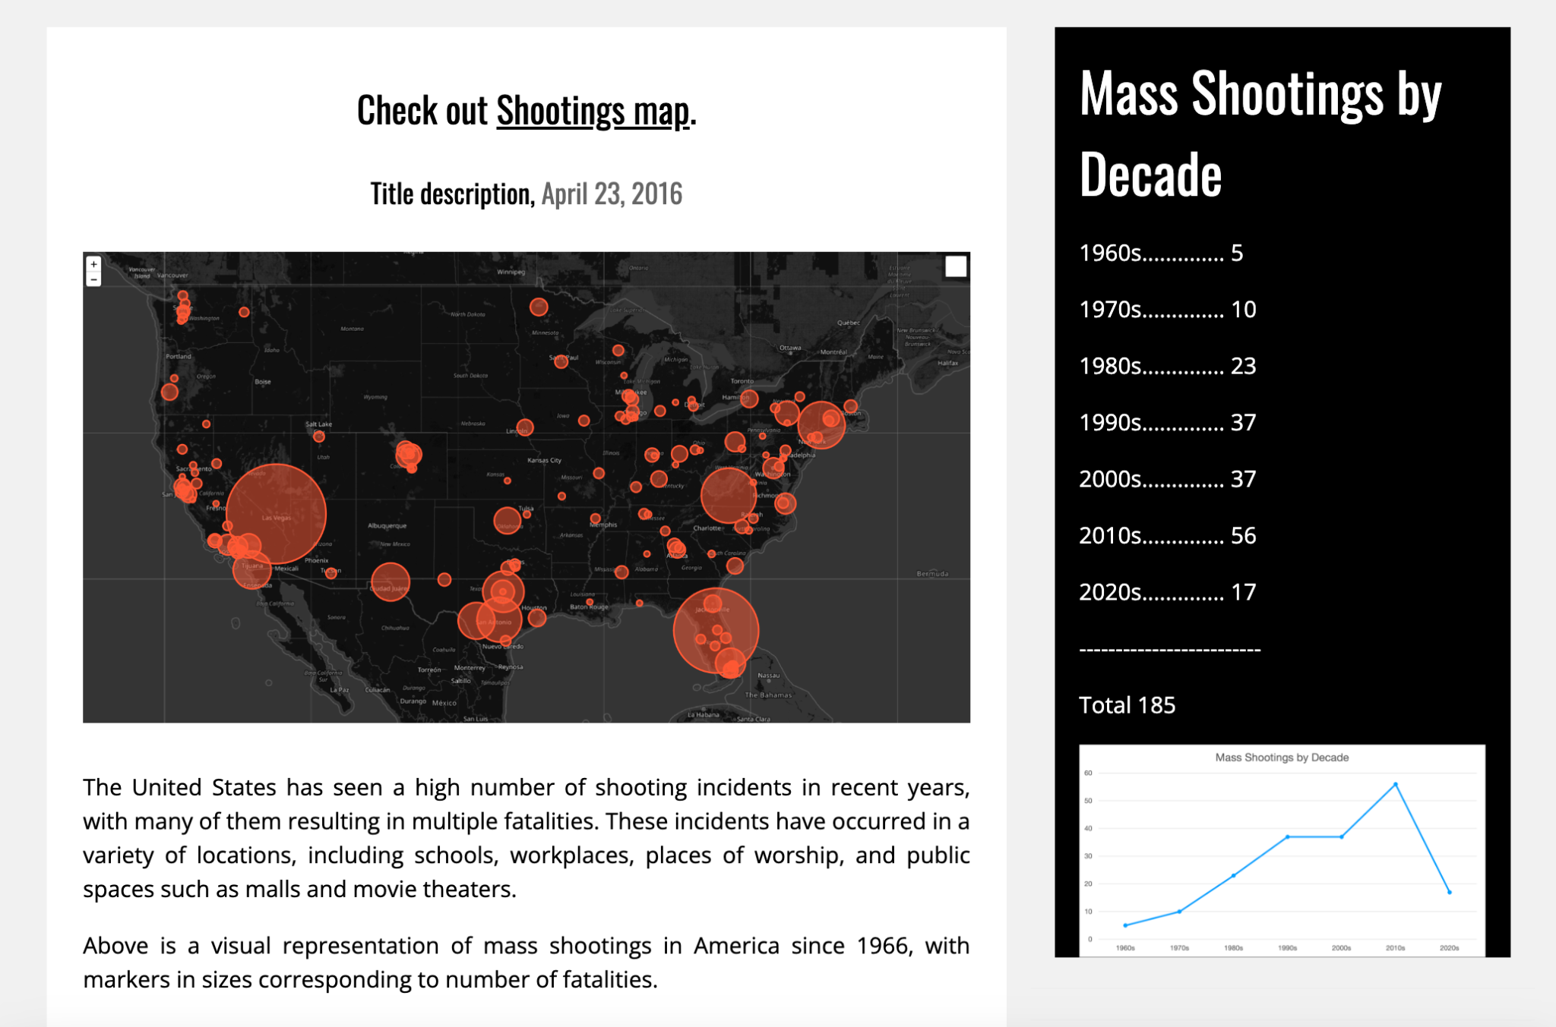
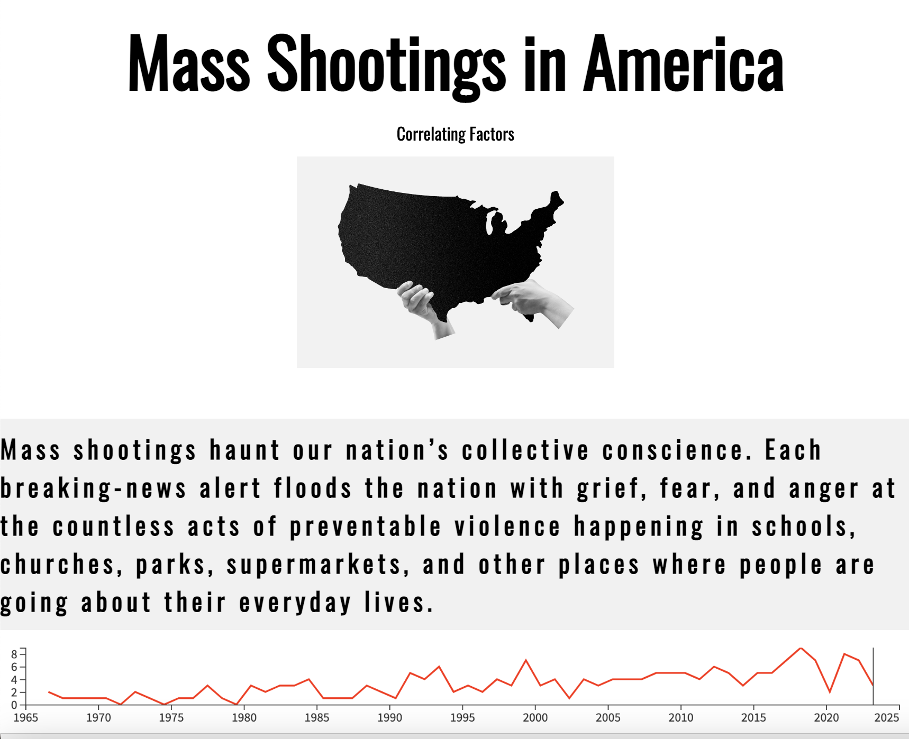
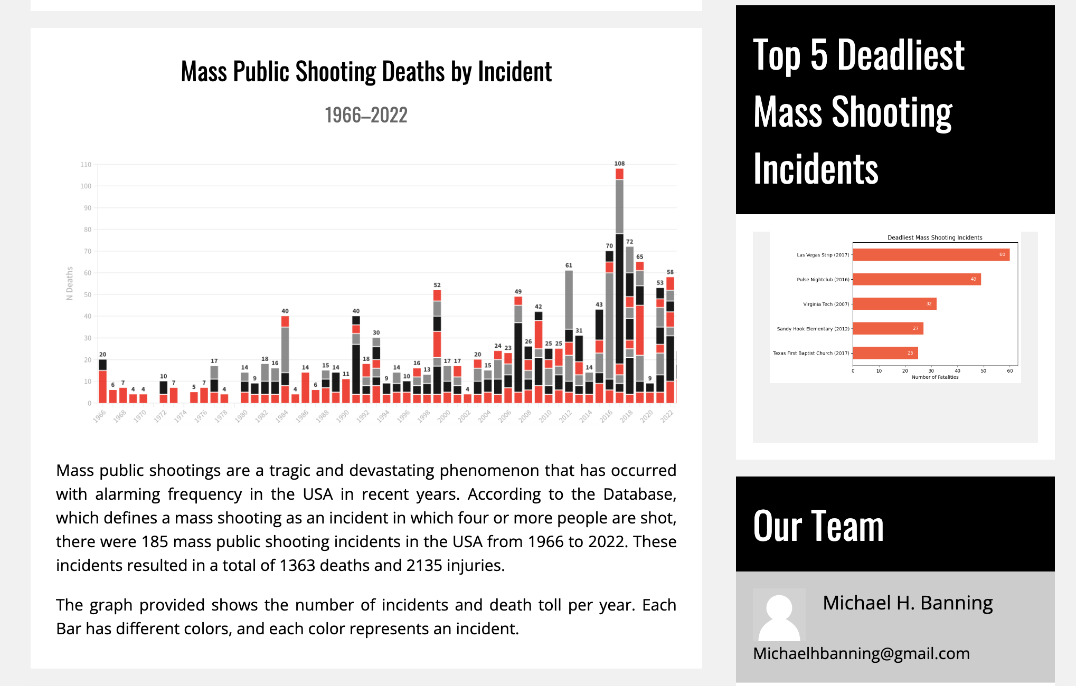
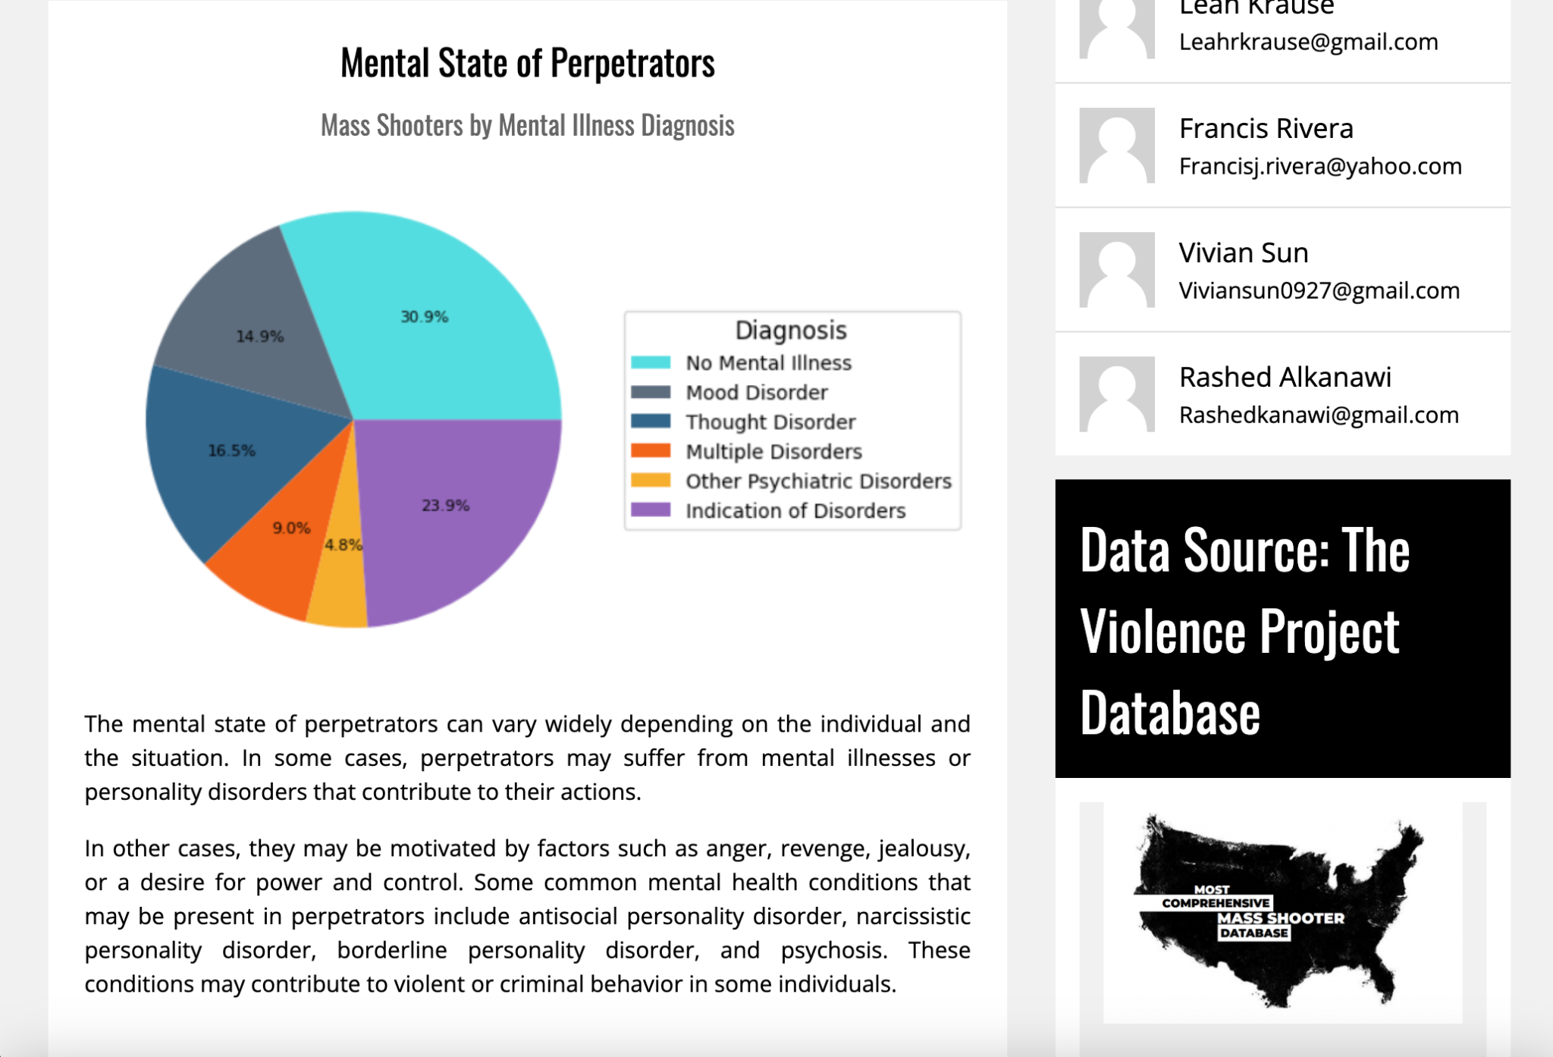
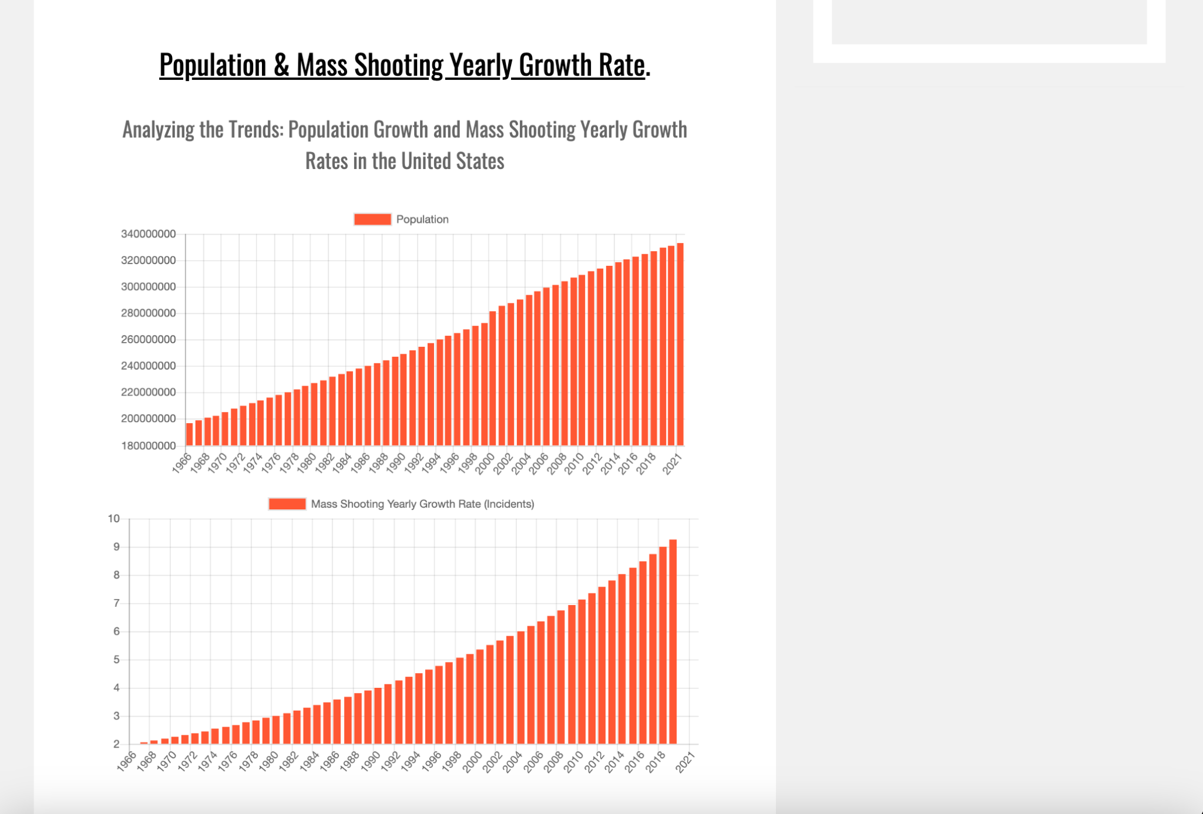
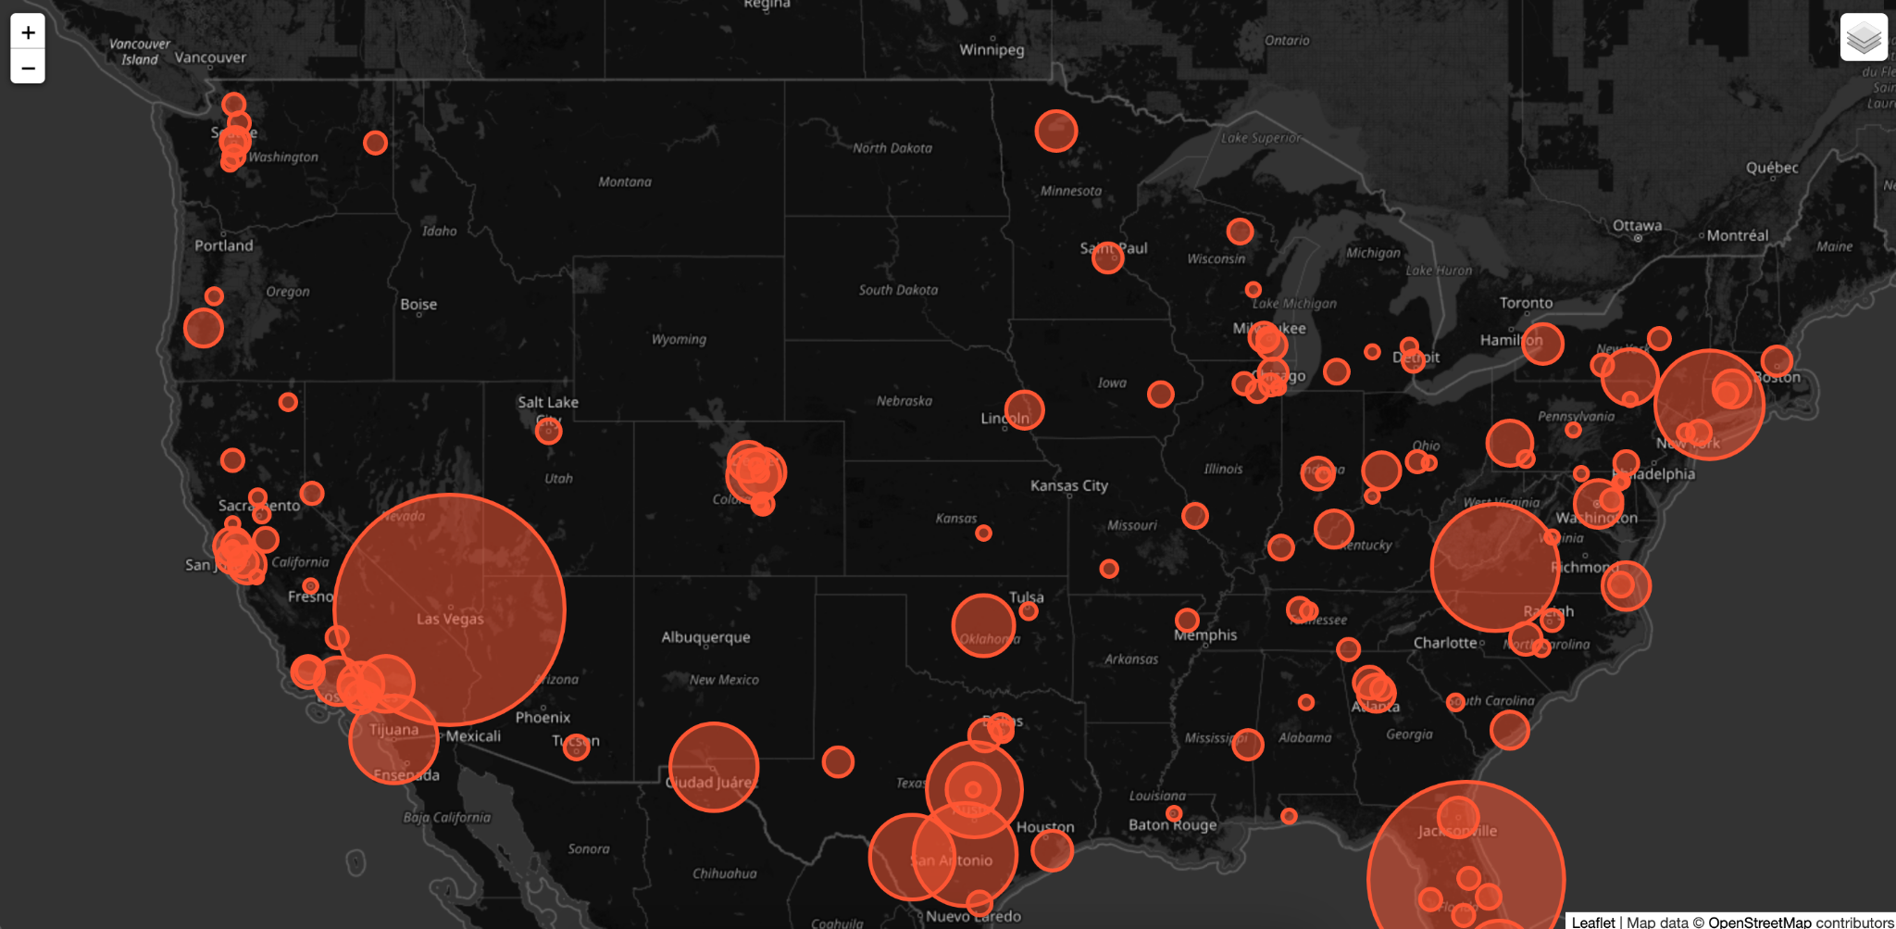

Slide 12





LET’S EXPLORE OUR WEB PAGE
http://project3.c1.biz/
https://www.biz.nf/
FREE WEB HOSTING

Slide 13
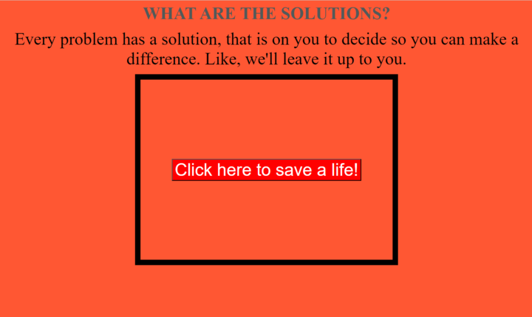
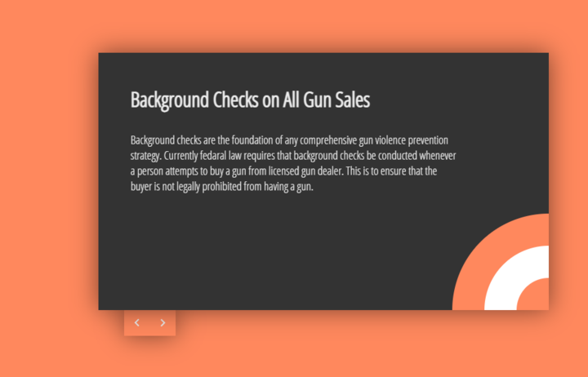
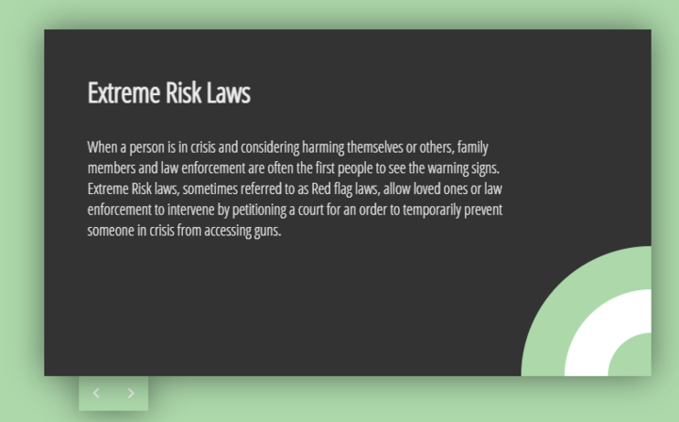
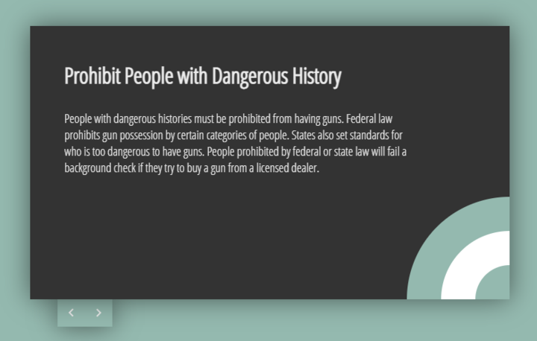
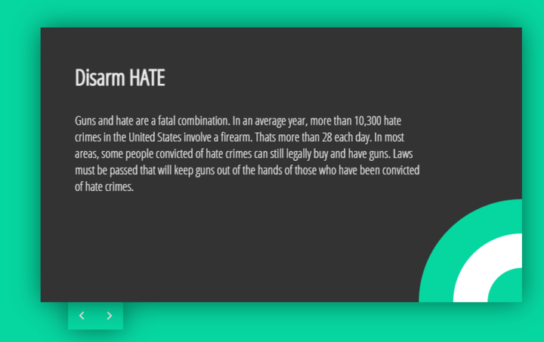
SOLUTION

Slide 14
CONCLUSION
We have concluded that mental illness does play a big part in mass shooting as ~50% in perpetrators show presence of mental disorders.
The majority of perpetrators are between the age of 20-40, also identified as male.
As the rate of mass shooting increases, the rate of intent shared on social media also increases.

